Slide 1

Travel Insurance Claim
Presented by – Mind Hack Buddies

Slide 2
Problem Statement
To predict if the Customer would claim Travel Insurance.

Slide 3
Potential Business Problems
Try to find out whether the Customer would Claim the Travel Insurance or not?
Company’s Revenue
Company’s Fund Management
Stakeholders
Company Chief Financial Officer
Company Chief Executive Officer
Company Claim Settlement Manager

Slide 4
Why Solve this Problem?
Business Impact
Improve Prediction -> Identify common features of claiming Travel Insurance -> Improve such common features
Improve Prediction -> Identify right claim raising audience -> Improve Strategies for such claim raising audience
Improve Prediction -> Identify right frequency of Claims -> Keep necessary funds ready to settle such claims
Improve Prediction -> Identify right frequency of Claims -> Optimize Company’s funds

Slide 5
Data
Dataset Information - The training dataset consists of data corresponding to 52310 customers and the test dataset consists of 22421 customers. There are 10 features.
Below are some of the features and Target variable:
ID | Numerical | Customer ID
Agency | Categorical | Name of Agency
Agency Type | Categorical | Type of Agency
Distribution Channel | Categorical | Type of Distribution Channel
Product Name | Categorical | Name of Product
Duration | Numerical | Duration of Travel
Destination | Categorical | Destination of Travel
Net Sales | Numerical | Net Sales Value
Commission (in value) | Numerical | Commission Value
Age | Numerical | Age of Traveller
Target Variable | Variable Type | Description
Claim | Numerical | Has the Customer claimed a Travel Insurance?

Slide 6
Evaluation Metric
The evaluation metric for this project is Precision Score.
False Positive -> predicted Customer will claim, but actually not claimed.
False Negative -> predicted Customer will not claim, but actually claimed.
For the use case, False Negative must be reduced. So Recall to be given more importance, but as per business requirements, we have considered Precision.

Slide 7
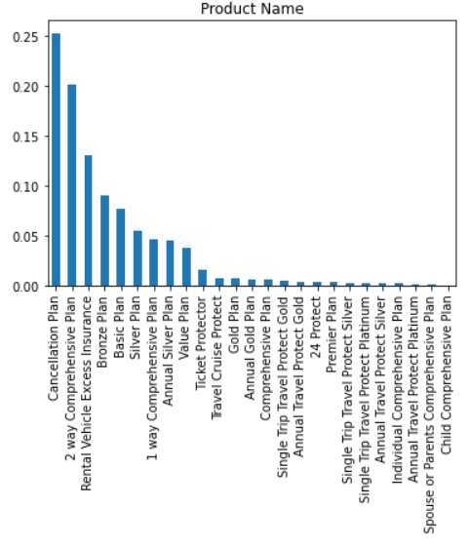
EDA – Univariate Analysis
Insight: People are more interested in "Cancellation Plan“.
Recommendation: In order to target more customers, Company should try to provide good packages for other products apart from "Cancellation Plan"

Slide 8
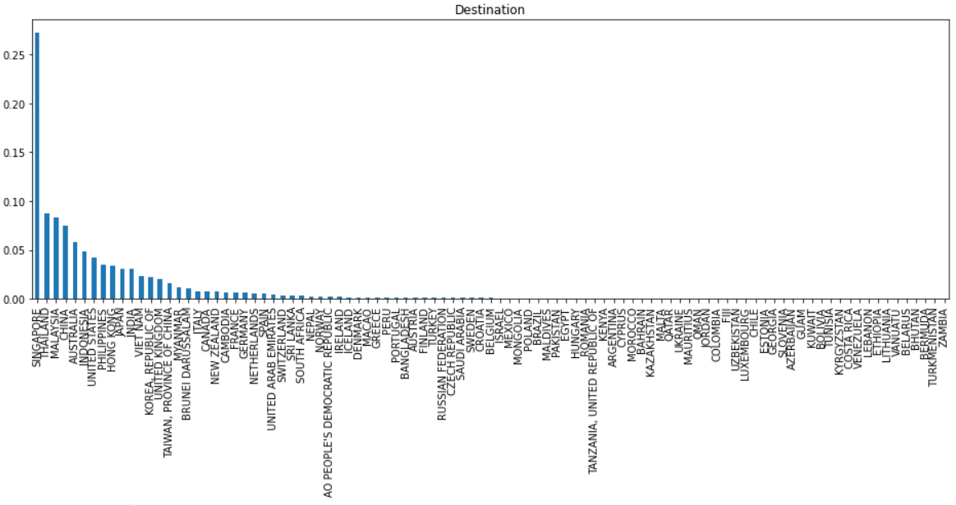
EDA – Univariate Analysis
Insight: People are more interested in "Singapore"(more popular destinations are Asian countries).
Recommendation: More popular destinations are Asian countries. Provide better packages for these countries.

Slide 9
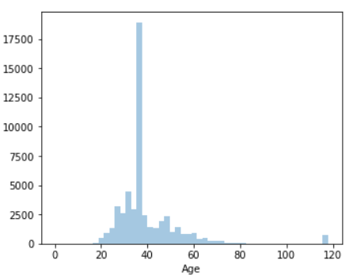
EDA – Univariate analysis
Insight: Maximum age group of travelers is 30 to 45.
Recommendation: Majority of customers are within age group of 30-45 and we need to focus on the customers within this age group.

Slide 10
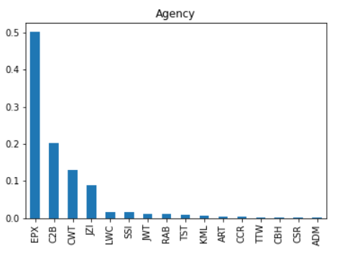
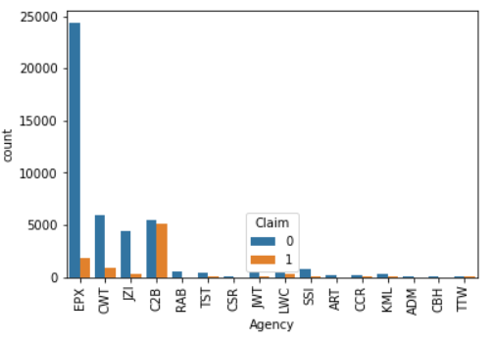
EDA – Bivariate Analysis
Insight: More number of Claims has been made by C2B Agency.
Recommendation: Company needs to check the reasons behind the maximum claims from C2B Agency.

Slide 11
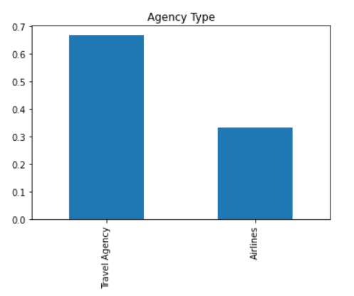
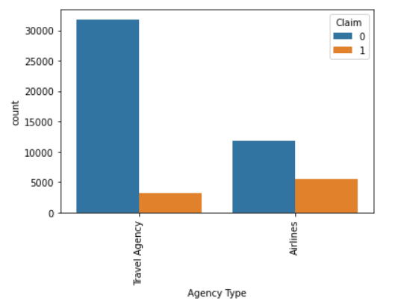
EDA – Bivariate Analysis
Insight: The Airlines Agency type has maximum claims even though it is not the maximum Business making Agency Type.
Recommendation: Company needs to investigate why there are maximum number of claims coming from Airlines Agency Type even though it is not the maximum Business making Agency Type.

Slide 12
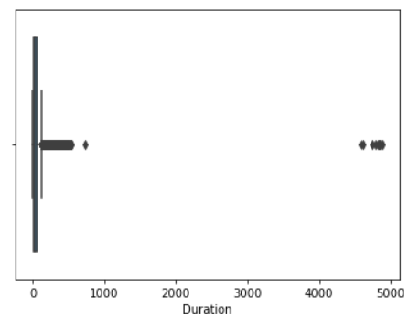
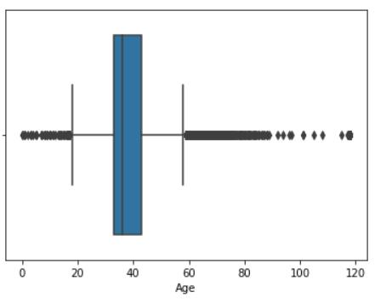
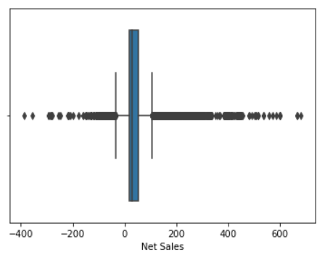
Pipeline
Outlier Treatment
The Outliers in the Continuous features were detected and treated using a method called IQR.

Slide 13
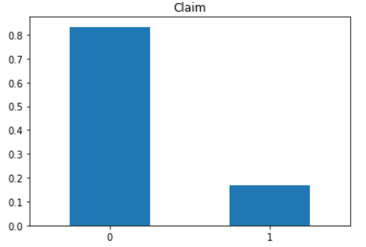
Pipeline
Missing Values
There were no missing values in the features.
Class Imbalance: The distribution of the target below shows a clear imbalance in the two classes.

Slide 14
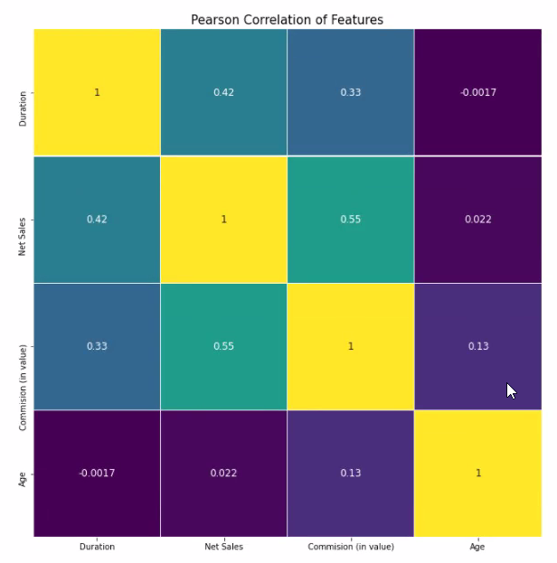
Pipeline
Feature Selection
Following methods were used for feature selection:
Corelation Heatmap
SelectKBest Model using f_classif

Slide 15
Models and Approaches
Five models were assessed without performing any hyperparameter tuning and without treatment of class imbalance of the target. The models were,
Logistics Regression
Decision Tree Classifier
Random Forest Classifier
XGBoost
Adaboost
None of the five models were able to give good Precision Score.
This called for treatment of class imbalance using Oversampling or Undersampling for further improvement of the Precision Score.

Slide 16
Models and Approaches
The vanilla models used yielded the following results below:
Modelling Method | Precision | Recall | ROC_AUC
Logistic Regression | 0.604123 | 0.273367 | 0.797352
DecisionTree Classifier | 0.697878 | 0.738714 | 0.856365
XGBoost | 0.62635 | 0.381797 | 0.88456
Adaboost | 0.594682 | 0.382801 | 0.860269
Random Forest Classifier | 0.781455 | 0.762585 | 0.960041

Slide 17
Model Tuning
After performing Oversampling and Undersampling, we found better results for Oversampling technique.
Amongst the Oversampling techniques, we have tried SMOTE and Random Oversampling. We got better results for Random Oversampling technique, which are as follows:
Modelling Method | Precision | Recall | ROC_AUC
Logistic Regression | 0.767388 | 0.711068 | 0.799929
DecisionTree Classifier | 0.933183 | 0.995013 | 0.968579
XGBoost | 0.807377 | 0.833438 | 0.889444
Adaboost | 0.7838 | 0.793316 | 0.862089
Random Forest Classifier | 0.941407 | 0.996762 | 0.992705

Slide 18
Final Results
From the above observations, it can be inferred that the best performing model was Random Forest Classifier giving Precision Score of 94.14%.

Slide 19
Insights and Decisions
Customers with Age Group between 30 to 45 are the most Travelers, Company needs to focus on these Customers and provide them better packages so that there will be reduction in Claims.
More popular destinations are Asian countries. Provide better packages for these countries in order to reduce Claim rate.

Slide 20


